Slide 1
Introduction- Phase I
------------------Suchandra Bose

Slide 2
Meaning of Accounting
Accounting Principles Board (APB) defines accounting in the following words : ‘Accounting is a service activity. Its function is to provide quantitative information primarily financial in nature, about economic entities that is intended to be useful in making economic decisions in making reasoned choices among alternative courses of action. Accounting includes several branches, e.g., financial accounting, managerial accounting and government accounting’.

Slide 3
Objectives of Accounting
To keep a systematic record of financial transactions that affect the business enterprise.
To ascertain the profits earned or losses incurred by the business unit during a particular accounting period.
To ascertain the financial position of the business unit at the end of the accounting period.
To exercise control over business assets and properties.
To facilitate business decision-making.

Slide 4
Advantages of Accounting
It provides information useful for making economic decisions.
It serves primarily those users who have limited authority, ability or resources to obtain information and who rely on financial statements as their principal sources of information about an enterprise’s economic activities.
It provides information useful to investors and creditors for predicting, comparing and evaluating potential cash flows in terms of amount, timing and related uncertainty.

Slide 5
Limitations
Accounting is historical in nature, it does not reflect the current financial position or worth of a business.
The Profit and Loss Account tends to match current revenues with historical costs (expenses) rather than current costs.
Accounting statements do not show the impact of inflation.
The Profit and Loss Account does not reflect those increases in net asset values which are not considered to be realized.
Accounting principles are not static ----alternative accounting procedures are often equally acceptable. Therefore, accounting statements do not always present comparable data.

Slide 6
Book Keeping
Book-keeping is an activity concerned with the recording of financial data related to business operations in a significant and orderly manner. Book-keeping is the record-making phase of accounting. Accounting is based on a careful and efficient book-keeping system.

Slide 7
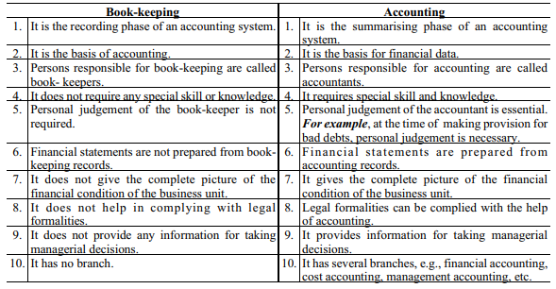
Differences between Book Keeping and Accounting

Slide 8
Users of Accounting Information
Investors : They supply the risk capital to the business unit. Ownership is separated from management in joint stock companies, hence, investors need to know how their money is being spent by the managers.
Lenders : Accounting information provides them with reasonable assurance as to the payment of interest and repayment of the principal
Suppliers : They normally sell on credit and they must have reasonable assurance that their credit will be honoured. Financial information helps them to decide about the credibility of the firm, and whether they should continue supplying on credit.

Slide 9
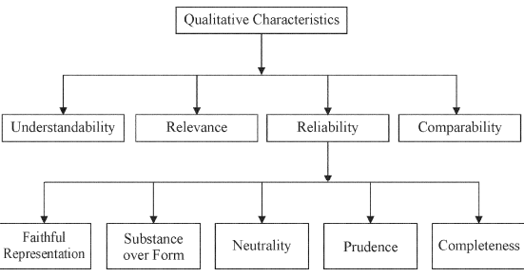
Qualitative Characteristics of Financial Statements

Slide 10
Class Exercise- Solve Yourself
What are the characteristics of modern accounting ?
Who are the users of accounting information ? Why do they need information ?
What are the qualitative characteristics of accounting information ?

